Slide 1


ST.JOSEPH
COLLEGE OF ENGINEERING
ANNA UNIVERSITY- CHENNAI 600 025
CLOUD APP FOR PNEUMONIA DETECTION
WITH GIVEN X-RAY IMAGES IN
DEEP LEARNING
PRESENTED BY
BALAJI .B (212920205005)
ELAVARASAN . E (21292020205011)
KARTHICK . S (212920205025)
SYED AKRAM. S (212920205055)
GUIDED BY
Mrs. M.R.SUREKHA M.E.,
Assistant professor,
Dept of Information Technology.

Slide 2
ABSTRACT
Pneumonia is a life-threatening infectious disease affecting one or both lungs in humans commonly caused by bacteria called Streptococcus pneumoniae. One in three deaths in India is caused due to pneumonia as reported by World Health Organization (WHO). This project describes the use of Deep Learning algorithms to process chest X-ray images in order to support the decision - making process in determining the correct diagnosis.
The application of Deep Learning in processing of medical images helps with consistency and boosts accuracy in reporting. We develop an algorithm that can detect pneumonia from chest X-rays at a level exceeding practicing radiologists. Our algorithm is CNN with vgg16, CNN with resnet50 and Unet. here our algorithm helps us to predict the amount of disease spread in chest.

Slide 3
INTRODUCTION
Pneumonia is an acute pulmonary infection that can be caused by bacteria, viruses, or fungi and infects the lungs, causing inflammation of the air sacs and pleural effusion, a condition in which the lung is filled with fluid.
It accounts for more than 15% of deaths in children under the age of five years. Pneumonia is most common in underdeveloped and developing countries, where overpopulation, pollution, and unhygienic environmental conditions exacerbate the situation, and medical resources are scanty.
Therefore, early diagnosis and management can play a pivotal role in preventing the disease from becoming fatal. Radiological examination of the lungs using computed tomography (CT), magnetic resonance imaging (MRI), or radiography (X-rays) is frequently used for diagnosis. X-ray imaging constitutes a non-invasive and relatively inexpensive examination of the lungs.

Slide 4
EXISTING SYSTEM
The success of deep learning algorithms in analyzing medical images, Convolutional Neural Networks (CNNs) have gained much attention for disease classification.
In addition, features learned by pre-trained CNN models on large-scale datasets are much useful in image classification tasks.
The functionality of pre-trained CNN models utilized as feature-extractors followed by different classifiers for the classification of abnormal and normal chest X-Rays. The system is build using CNN model to detect pneumonia in the given x-ray image.

Slide 5
PROPOSED SYSTEM
We develop an Web App for algorithm that can detect pneumonia from chest X-rays at a level exceeding practicing radiologists.
Our algorithm is CNN with vgg16, CNN with resnet50 and Unet. here our algorithm helps us to predict the amount of disease spread in chest.
This Web Application deployed in the cloud platform as real time application.

Slide 6
LITERATURE REVIEW
P. K. Pawłowski: In this paper, the work was done by Convolutional Neural Network (CNN), which is the deep learning method and tries extract each and every feature init. The dataset used was from Kaggle, online open-source platform to machine learning. Here, the data are in the form X-ray image of pneumonia lungs. They have implemented this training phase on four CNN models and these models were differentiated by dropout layers which are introduced in between them.
Arpan Mangal’s : had their research on some of the COVID detection using the chest x-rays through the deep learning algorithms. In this work, they created a model with convolution layer and named as CovidNet which helps to detect the COVID-19 disease. As they mentioned that the RTPCR test would take too long time for final results and also highlighted about the time efficiency of their model during detection. The data used for training model was chest X-rays. They claimed that their model works with efficiency of 90.5% with 100% sensitivity.

Slide 7
REQUIREMENT ANALYSIS AND SPECIFICATIONS
The requirement engineering process of feasibility study, requirements elicitation and analysis, requirement specification, requirements validation and requirement management.
Requirement elicitation and analysis is an iterative process that can be represented as a spiral of activities, namely requirements discovery, requirements classification and organization, requirement negotiation and requirements documentation.

Slide 8
FEASIBILITY STUDY
A feasibility study is carried out to select the best system that meets performance requirements. The main aim of the feasibility study activity is to determine that it would be financially and technically feasible to develop the product.
Technical Feasibility : This is concerned with specifying the software will successfully satisfy the user requirement. Open source and business-friendly and it is truly cross platform, easily deployed and highly extensible.
Economic Feasibility : Economic analysis is the most frequently used technique for evaluating the effectiveness of a proposed system. The enhancement of the existing system doesn’t incur any kind of drastic increase in the expenses

Slide 9
REQUIREMENTS
SOFTWARE REQUIREMENTS:
Operating System : windows 10,11
Model Training : Python 3, Open CV, Tensorflow, Jupyter notebook, Kaggle
Deployment: Python Flask App, Heroku Cloud Platform
HARDWARE REQUIREMENTS:
512 MB RAM
2.5GHz refresh rate
I5 Intel Processor

Slide 10
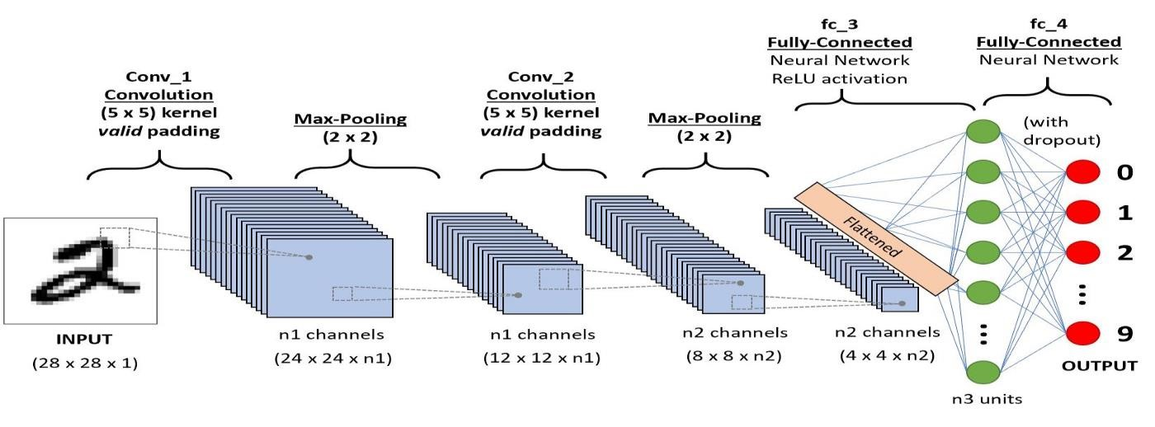
CNN SYSTEM ARCHITECTURE

Slide 11
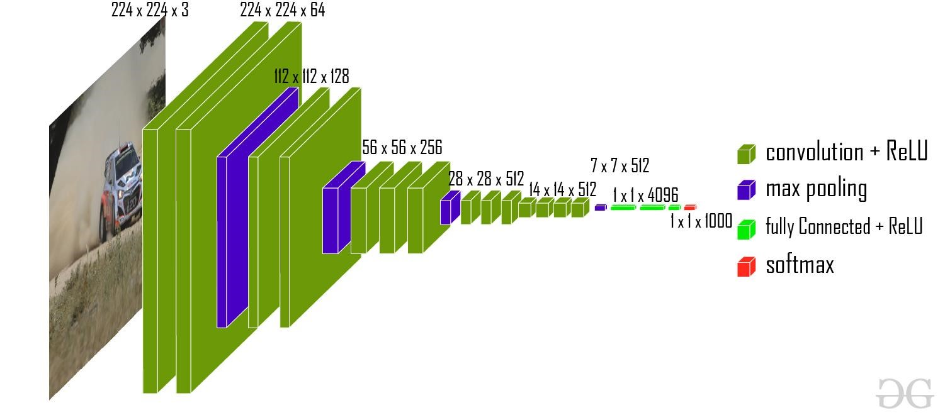
CNN with vgg16

Slide 12
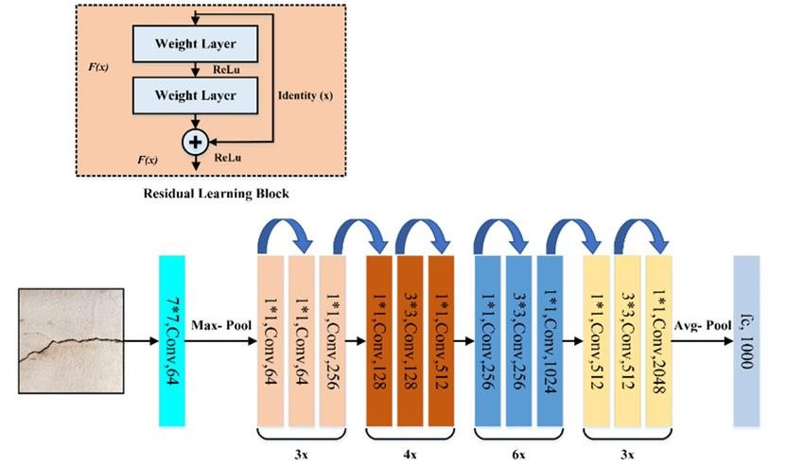
CNN with resnet50

Slide 13
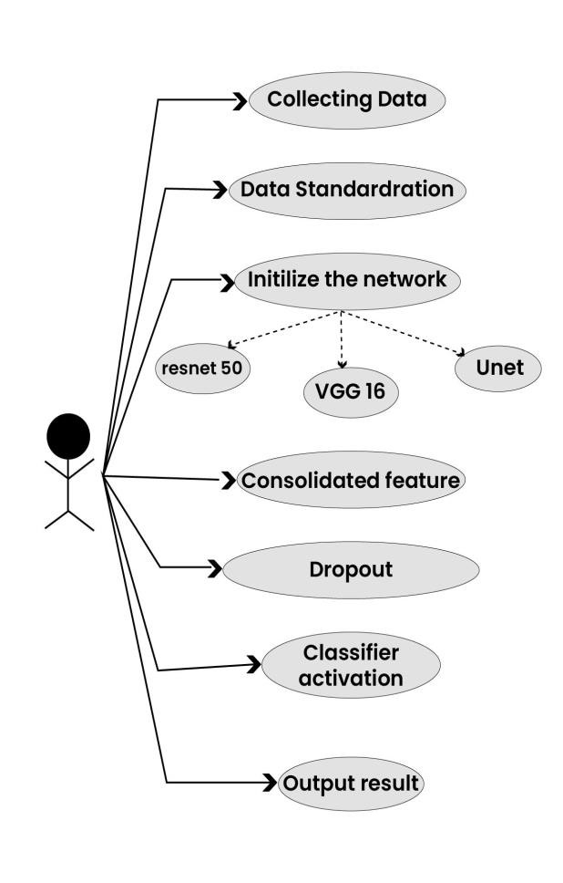
UML DIAGRAM

Slide 14
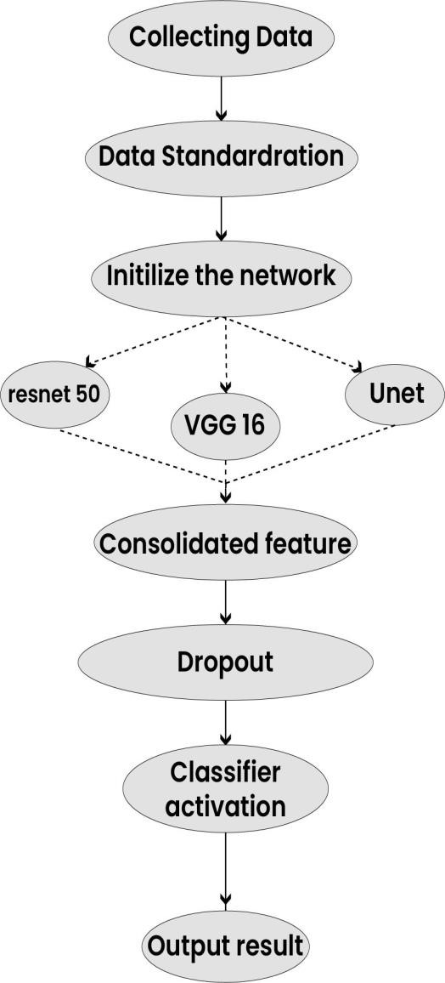
ACTIVITY DIAGRAM

Slide 15
DOMAIN
Deep Learning(CNN)
ALGORITHM
CNN with vgg16 | CNN with resnet50 | Unet
Dependencies : Python 3, OpenCV, Tensorflow

Slide 16
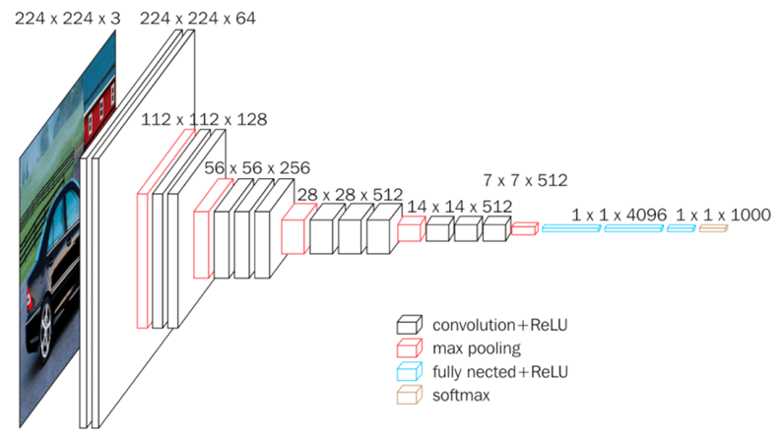
CNN with vgg16 | CNN with resnet50 | Unet
VGG16 is a convolution neural net (CNN) architecture which was used to win ILSVR (Imagenet) competition in 2014.
It is considered to be one of the excellent vision model architecture till date

Slide 17
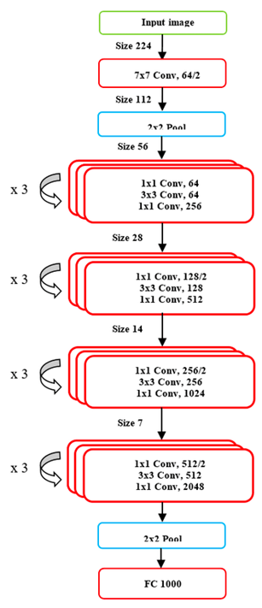
CNN with vgg16 | CNN with resnet50 | Unet
ResNet-50 is a Cnn That Is 50 layers deep. the network trained on more than a million images from the ImageNet database.
The pretrained network can classify images into 1000 object categories, such as keyboard, computer, pen, and many hourse.

Slide 18
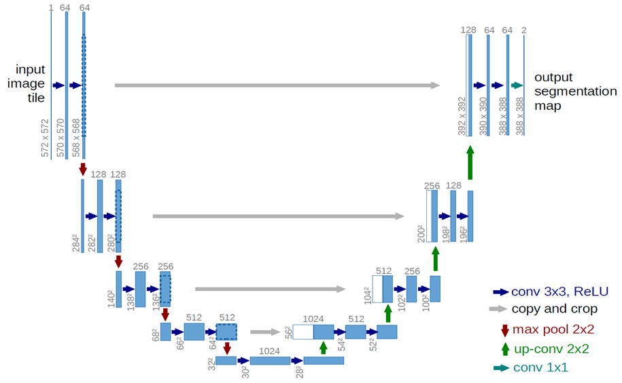
CNN with vgg16 | CNN with resnet50 | Unet
U-Net is an architecture for semantic segmentation. It consists of a contracting path and an expansive path.
The contracting path follows the typical architecture of a convolutional network.

Slide 19
MODULES
Data Processing
Training
Testing &
Evoluating Model

Slide 20
DATA PROCESSING
Data processing is a critical step in developing any machine learning model, including one for pneumonia detection from X-ray images. Here's a detailed outline of the data processing steps you might take.
Resize: Resize all images to a uniform size to ensure consistency. The typical size for medical image analysis is often 224x224 or 256x256 pixels.
Normalization: Normalize pixel values to a common scale, usually between 0 and 1 or -1 and 1. This helps the model converge faster during training.
Data Balancing (if necessary): Ensure that the distribution of pneumonia and non-pneumonia cases is balanced in the training dataset to prevent bias towards the majority class.

Slide 21
TRAINING
Iterate over mini-batches of training data.
Forward pass: Pass the input images through the model to obtain predictions.
Compute the loss between the predicted labels and the ground truth labels.
Backward pass: Compute gradients of the loss with respect to the model parameters.
Update model parameters using the chosen optimization algorithm.
Repeat the process until convergence criteria are met (e.g., a maximum number of epochs or reaching a desired level of performance).

Slide 22
TESTING
Testing a deep learning model for pneumonia detection using X-ray images is crucial to assess its performance and reliability.
Here's a detailed guide on how to conduct testing Prepare the Test Dataset Ensure that you have a separate dataset reserved for testing purposes. This dataset should be distinct from the training and validation sets to evaluate the model's generalization ability accurately. Data Preprocessing Apply the same preprocessing steps to the test dataset that you used during training and validation.
This includes resizing, normalization, and any other necessary transformations. Load the Trained Model Load the trained deep learning model that you saved after training. Perform Inference Use the trained model to make predictions on the test dataset. Pass the preprocessed X-ray images through the model and obtain the predicted class labels (pneumonia or non-pneumonia).

Slide 23
EVOLUATING MODEL
The proportion of correctly classified samples out of the total number of samples.
The proportion of true positive predictions among all positive predictions. It measures the model's ability to avoid false positives. The proportion of true positive predictions among all actual positive samples. It measures the model's ability to capture positive cases.
The proportion of true negative predictions among all actual negative samples. the model’s ability to correctly identify negative cases.
The harmonic mean of precision and recall, providing a balanced measure of the model's performance.
The Receiver Operating Characteristic (ROC) curve plots the true positive rate against the false positive rate at various threshold settings. The Area Under the Curve (AUC) score summarizes the ROC curve's performance, with a higher AUC indicating better model performance.

Slide 24
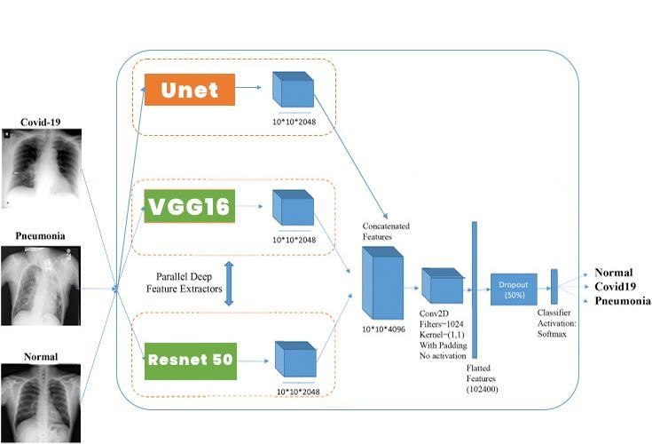
ARCHITECTURAL DIAGRAM

Slide 25
SAMPLE CODING
app = Flask(__name__)
def predict(values, dic): if len(values) == 8: model = pickle.load(open('models/diabetes.pkl','rb')) values = np.asarray(values) return model.predict(values.reshape(1, -1))[0] elif len(values) == 26: model = pickle.load(open('models/breast_cancer.pkl','rb')) values = np.asarray(values) return model.predict(values.reshape(1, -1))[0] elif len(values) == 13: model = pickle.load(open('models/heart.pkl','rb')) values = np.asarray(values) return model.predict(values.reshape(1, -1))[0] elif len(values) == 18:
model = pickle.load(open('models/kidney.pkl','rb')) values = np.asarray(values) return model.predict(values.reshape(1, -1))[0] elif len(values) == 10:
model = pickle.load(open('models/liver.pkl','rb')) values = np.asarray(values)
return model.predict(values.reshape(1, -1))[0]
@app.route("/")

Slide 26
{% extends 'main.html' %}
{% block content %}
<script>
function readURL(input) {
if (input.files && input.files[0]) { var reader = new FileReader();
reader.onload = function (e) {
$('#blah')
.attr('src', e.target.result)
.width(500)
.height(500);
};
reader.readAsDataURL(input.files[0]);
}
}
</script>
{% if message %}
<div class="alert alert-danger">{{ message }}</div>

Slide 27
@app.route("/") def home():
return render_template('home.html')
@app.route("/diabetes", methods=['GET', 'POST']) def diabetesPage():
return render_template('diabetes.html')
@app.route("/cancer", methods=['GET', 'POST']) def cancerPage():
return render_template('breast_cancer.html')
@app.route("/heart", methods=['GET', 'POST']) if request.method == 'POST':
to_predict_dict = request.form.to_dict() to_predict_list = list(map(float, list(to_predict_dict.values()))) pred = predict(to_predict_list, 'models/diabetes.h5') except Exception as e:
message = f"Error: {str(e)}" return render_template("home.html", message=message)
return render_template('predict.html', pred=pred)

Slide 28
def home(): return render_template('home.html')
@app.route("/diabetes", methods=['GET', 'POST']) def diabetesPage(): return render_template('diabetes.html')
@app.route("/cancer", methods=['GET', 'POST']) def cancerPage(): return render_template('breast_cancer.html')
@app.route("/heart", methods=['GET', 'POST']) def heartPage(): return render_template('heart.html')
@app.route("/kidney", methods=['GET', 'POST']) def kidneyPage(): return render_template('kidney.html')
@app.route("/liver", methods=['GET', 'POST']) def liverPage(): return render_template('liver.html')
@app.route("/malaria", methods=['GET', 'POST']) def malariaPage(): return render_template('malaria.html')
@app.route("/pneumonia", methods=['GET', 'POST']) def pneumoniaPage():
return render_template('pneumonia.html')
@app.route("/predict", methods = ['POST', 'GET']) def predictPage(): try: if request.method == 'POST': to_predict_dict = request.form.to_dict()
to_predict_list = list(map(float, list(to_predict_dict.values()))) pred = predict(to_predict_list, to_predict_dict) except:
message = "Please enter valid Data"
return render_template("home.html", message = message)
return render_template('predict.html', pred = pred)
@app.route("/malariapredict", methods = ['POST', 'GET'])

Slide 29
def malariapredictPage(): if request.method == 'POST': try: if 'image' in request.files:
img = Image.open(request.files['image']) img = img.resize((36,36)) img = np.asarray(img) img = img.reshape((1,36,36,3)) img = img.astype(np.float64) model = load_model("models/malaria.h5") pred = np.argmax(model.predict(img)[0]) except:
message = "Please upload an Image"
return render_template('malaria.html', message = message) return render_template('malaria_predict.html', pred = pred)
@app.route("/pneumoniapredict", methods = ['POST', 'GET']) def pneumoniapredictPage(): if request.method == 'POST': try: if 'image' in request.files:
img = Image.open(request.files['image']).convert('L') img = img.resize((36,36)) img = np.asarray(img) img = img.reshape((1,36,36,1)) img = img / 255.0
model = load_model("models/pneumonia.h5") pred = np.argmax(model.predict(img)[0]) except:
message = "Please upload an Image" return render_template('pneumonia.html', message = message) return render_template('pneumonia_predict.html', pred = pred)
if __name__ == '__main__':
app.run(debug = True)

Slide 30
def home(): return render_template('home.html') @app.route("/diabetes", methods=['GET', 'POST']) def diabetesPage(): return render_template('diabetes.html') @app.route("/cancer", methods=['GET', 'POST']) def cancerPage(): return render_template('breast_cancer.html') @app.route("/heart", methods=['GET', 'POST']) def heartPage(): return render_template('heart.html') @app.route("/kidney", methods=['GET', 'POST']) def kidneyPage(): return render_template('kidney.html') @app.route("/liver", methods=['GET', 'POST']) def liverPage(): return render_template('liver.html') @app.route("/malaria", methods=['GET', 'POST']) def malariaPage(): return render_template('malaria.html') @app.route("/pneumonia", methods=['GET', 'POST']) def pneumoniaPage(): return render_template('pneumonia.html') @app.route("/predict", methods = ['POST', 'GET']) def predictPage(): try: if request.method == 'POST': to_predict_dict = request.form.to_dict() to_predict_list = list(map(float, list(to_predict_dict.values()))) pred = predict(to_predict_list, to_predict_dict) except: message = "Please enter valid Data" return render_template("home.html", message = message) return render_template('predict.html', pred = pred) @app.route("/malariapredict", methods = ['POST', 'GET'])

Slide 31
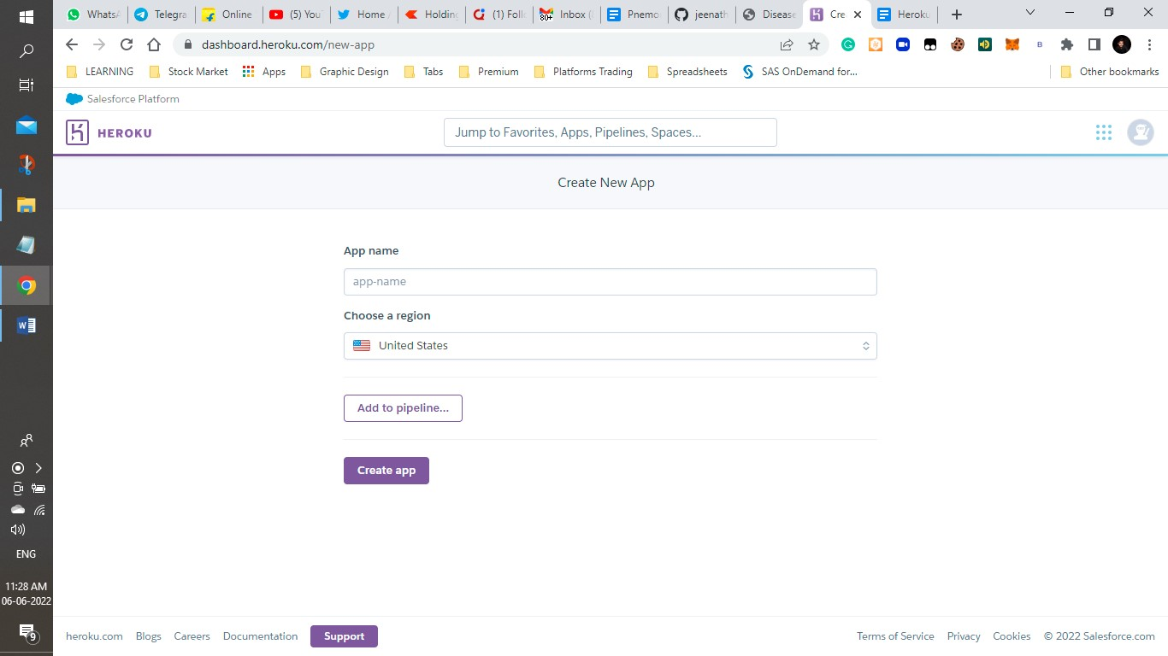
Deploying in Heroku Cloud Platform: Install the Heroku CLI

Slide 32
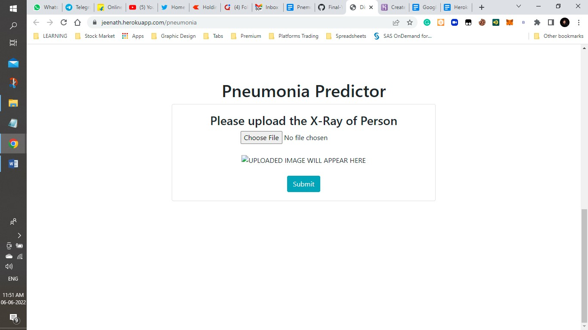
SAMPLE SCREEN

Slide 33
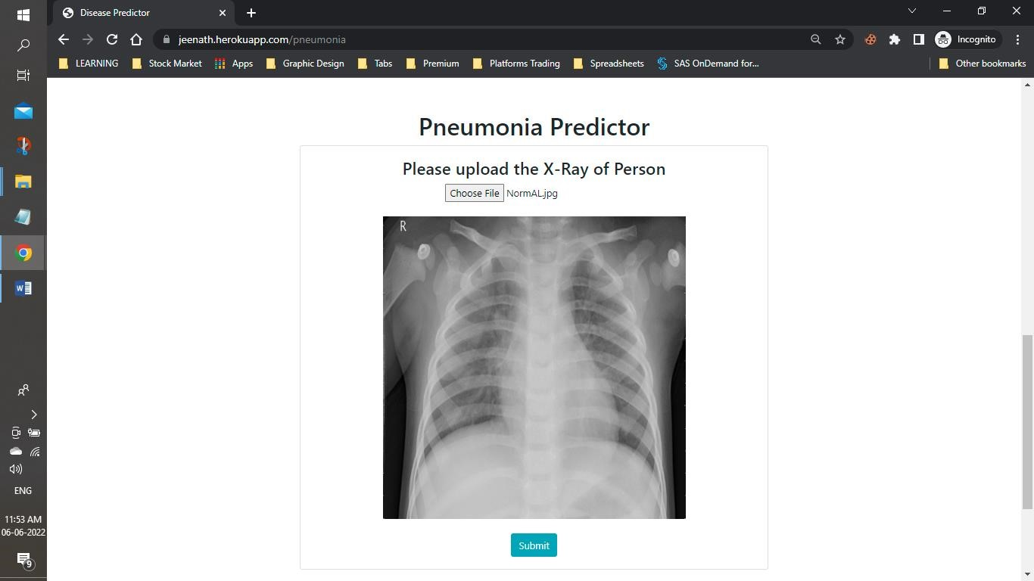

Slide 34
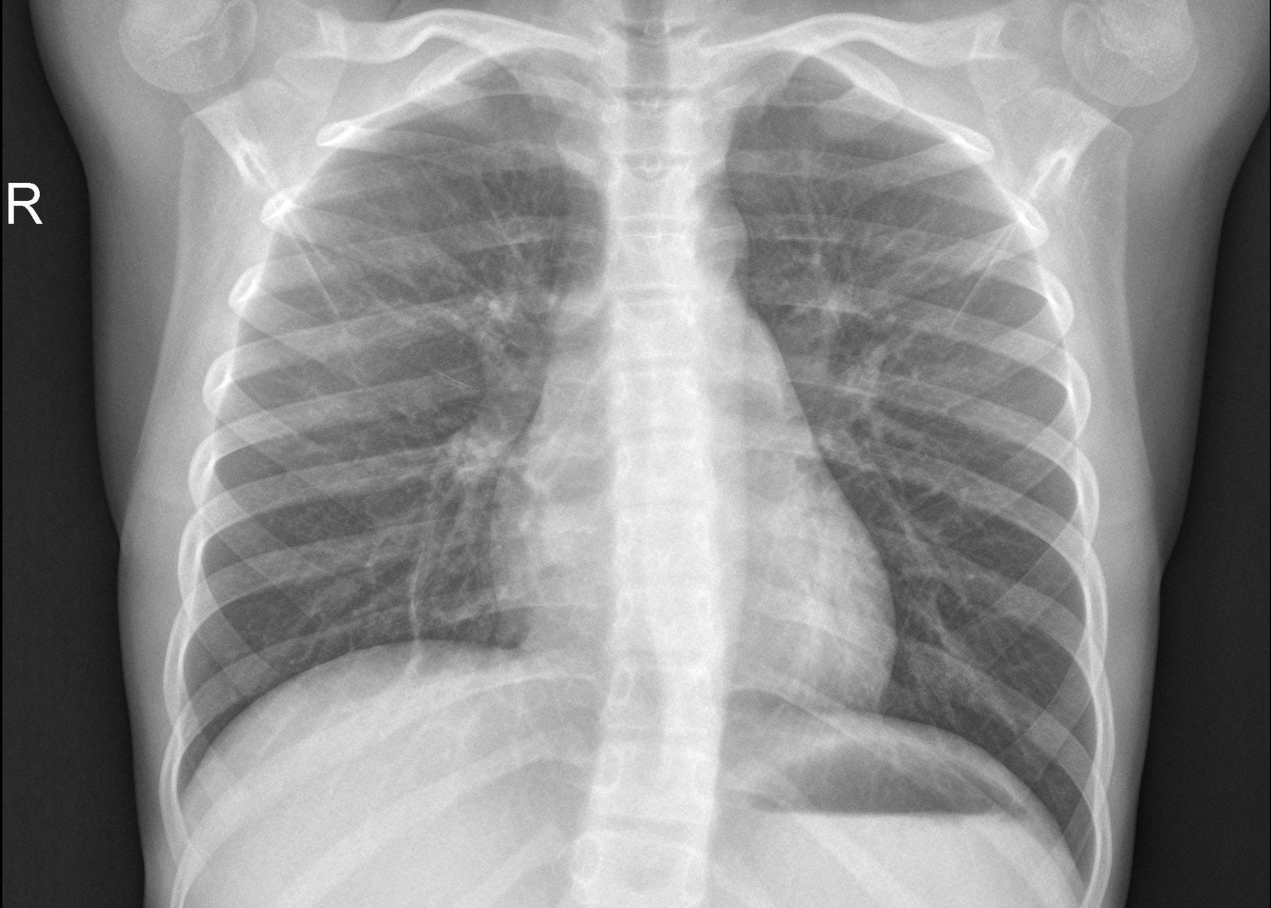

SAMPLE OUTPUT - NORMAL

Slide 35
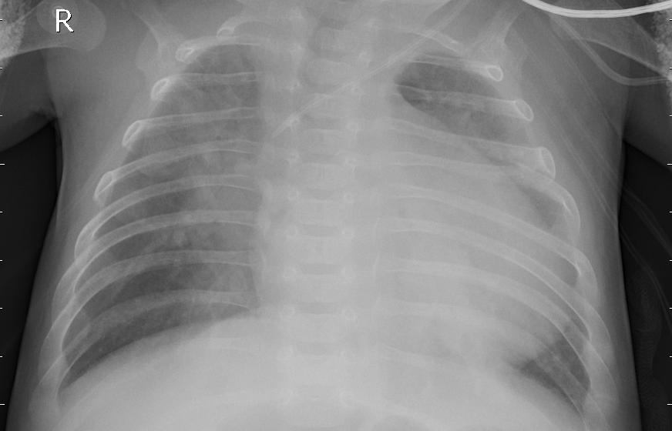
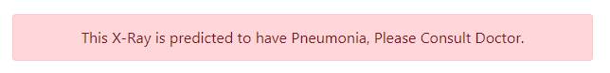
SAMPLE OUTPUT - PNEUMONIA

Slide 36
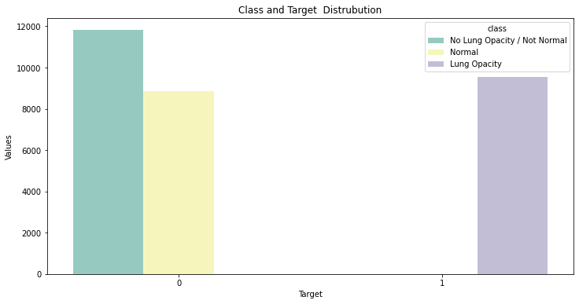
CLASS AND TARGET DISTRUBUTION

Slide 37
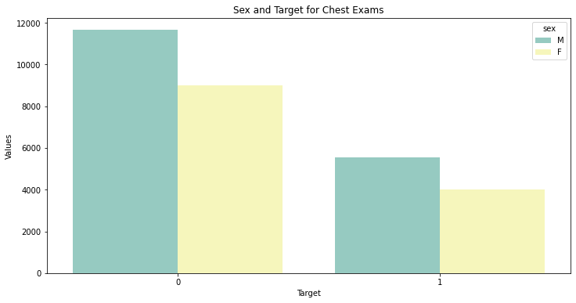
TARGET FOR CHEST EXAMS

Slide 38
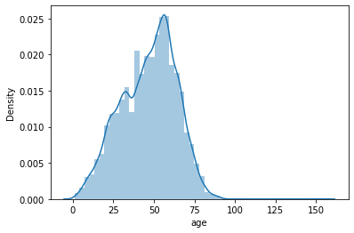
FLOWCHART

Slide 39
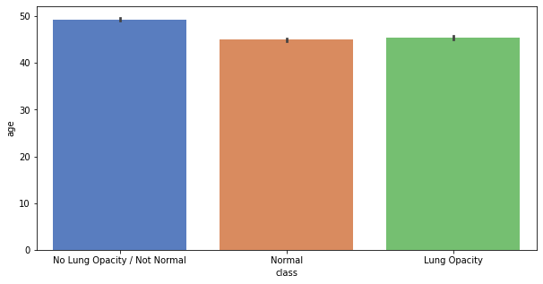
MAXIMUM AGE OF PERSON WITH PNEUOMINA IS AROUND 45

Slide 40
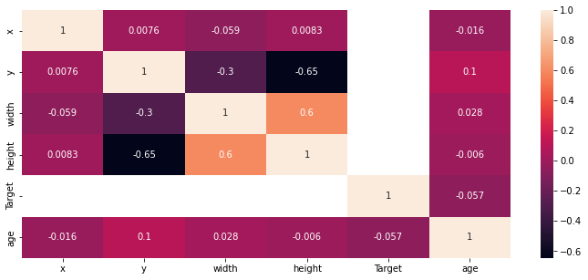
OUTPUT

Slide 41
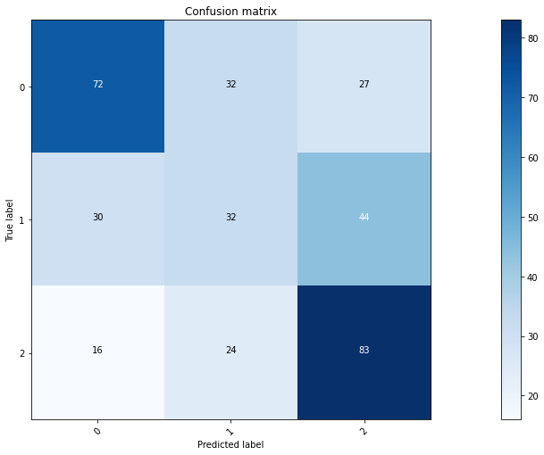
VALIDATION DATASET

Slide 42
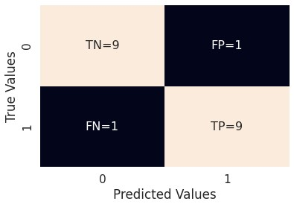
INPUT

Slide 43
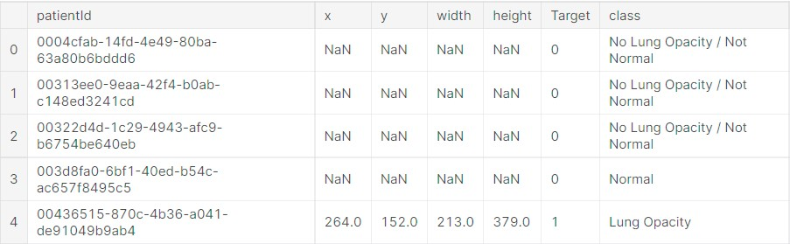
training_data.head() Out[24]

Slide 44
TEST CASES
Test Case Id | Test Cases | Priority | Input Test Data | Expected Results | Output Results | Pass / Fail
TC01 | Gender | A | X Ray from Test dataset | Male | Male | Pass
TC02 | Age | A | - | Notification should be received properly | Alert Message received properly | Pass
TC03 | Detect Pneumonia | A | X Ray from Test dataset | Pneumonia Detected | Pneumonia Detected | Pass

Slide 45
ADVANTAGES
As we are using CNN model this can run in system with lesser RAM
Low cost to build
Ability to covertly
DISADVANTAGES
Needs large set of annotated data
Probability may differ on their obesity.

Slide 46
CONCLUSION
CNN Deep Learning Algorithm showed better results in pneumonia detection with max accuracy. The deep learning algorithms has its benefits when comparative to machine learning algorithms.
But the main problem is computational cost and is high. In each and every problem, like detection, prediction, classification, recommendation systems in medical industry adopting deep learning algorithms for better precise decisions.
Moreover, the deep learning algorithms gives the results in no less than time which could be helpful to doctors in case of treatments.

Slide 47
FUTURE ENHANCEMENT
In the future, it is hoped that transfer learning models would be trained on this dataset that would outperform these CNN models.
It is intended that larger datasets will also be trained using the models presented in the paper.
It is also expected that neural network models based on GAN, generative adversarial networks, would also be trained and compared with the existing models

Slide 48
REFERENCE
O. Stephen, M. Sain, U. J. Maduh and D.-U. Jeong, "An Efficient Deep Learning Approach to Pneumonia Classification in Healthcare," Journal of HealthCare Engineering, vol. 2019, 2019.
Nadpara H, Kushwaha K, Patel R, Doshi N. A Survey of Cryptographic Techniques to Secure Genomic Data. Vol. 121, Lecture Notes in Networks and Systems. 2020.
Jaiswal AK, Tiwari P, Kumar S, Gupta D, Khanna A, Rodrigues JJPC. Identifying pneumonia in chest X-rays: A deep learning approach. Meas J Int Meas Confed. 2019
Kim DH, MacKinnon T. Artificial intelligence in fracture detection: transfer learning from deep convolutional neural networks. Clin Radiol. 2018
Rubin J, Sanghavi D, Zhao C, Lee K, Qadir A, Xu-Wilson M. Large scale automated reading of frontal and lateral chest x-rays using dual convolutional neural networks. arXiv.
2018.

Slide 49
REFERENCE
"A Lightweight Deep Learning-Based Pneumonia Detection Approach for EnergyEfficient Medical Systems", https://www.hindawi.com/journals/wcmc/2021/5556635/
“Pneumonia detection in chest X-ray images using an ensemble of deep learning models” https://journals.plos.org/plosone/article?id=10.1371/journal.pone.0256630
Deep Learning for Detecting Pneumonia from X-ray Images"https://towardsdatascience.com/deep-learning-for-detecting-pneumonia-from-x-rayimages-fc9a3d9fdba8"

Slide 50
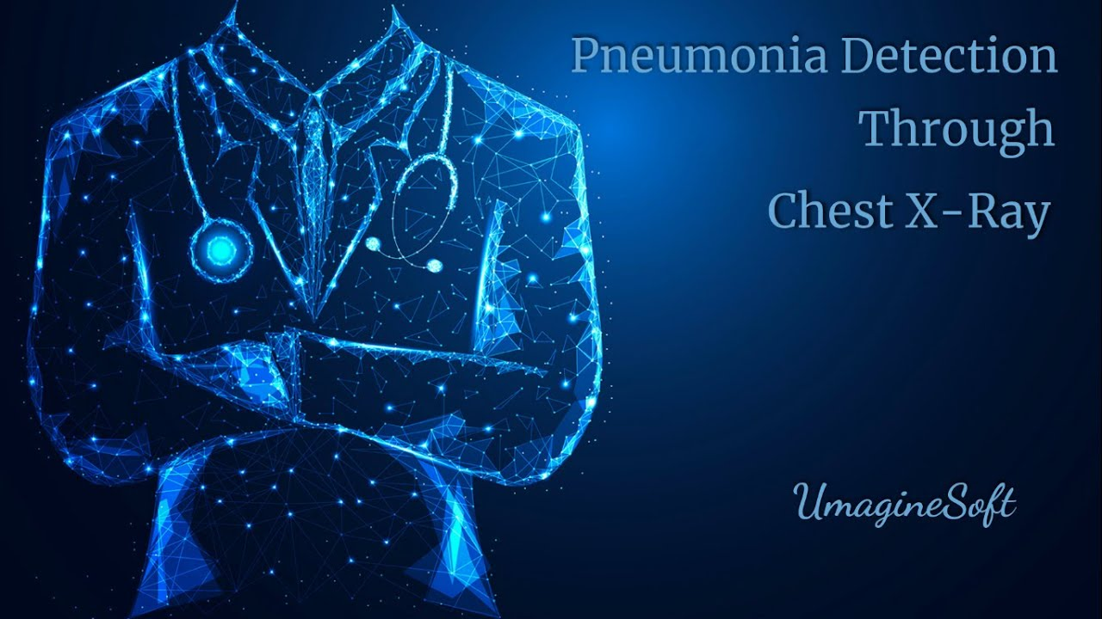
THANK YOU

